Slide 1
Credit card fraud detection
By. Vaishali Raheja
MCA-AIML3
UID: 21MCI1202

Slide 2
Credit card fraud
Credit card fraud occurs when an unauthorized person gains access to your information and uses it to make purchases. Here are some ways fraudsters get your information:
Lost or stolen credit cards
Skimming your credit card, such as at a gas station pump
Hacking your computer
Calling about fake prizes or wire transfers
Phishing attempts, such as fake emails
Looking over your shoulder at checkout
Stealing your mail

Slide 3
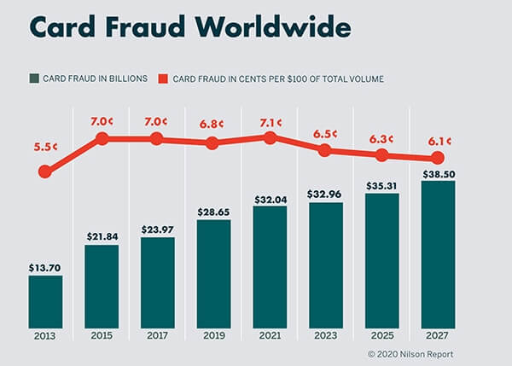
Recent study shows………
Recent studies shows that there has been increase in the credit card frauds with the concept of digitalization. Hackers get in between your network and stays there in wait of the moment you make a transaction. They steal your data and also your hard earned money.
So!!
There is a need for intelligent model that can differentiate between a fraudalent transaction and a legit one.

Slide 4
What is the way?
DATA
DATA
DATA
DATA
DATA
Hi!! I am data, If you are looking for a intelligent solution for your problem then we can become good friends.
Yes! Based on previous data about transactions done by the credit card we can train our model for fraud detection using machine learning algorithms. In this project we will use the already stored database to find an optimal solution for our problem. Once we prepare an intelligent model we can deploy that model to banks for fraud detection.

Slide 5
Let’s build our machine learning model
Reading dataset and performing EDA.
Data Visualization
Training model using machine learning algorithm

Slide 6
1. Obtaining Dataset
Credit card dataset can be downloaded from Kaggle. This dataset is in csv format. The link for dataset is:
https://www.kaggle.com/datasets/mlg-ulb/creditcardfraud

Slide 7

About the dataset..
This dataset presents transactions that occurred in two days, where we have 492 frauds out of 284,807 transactions. The dataset is highly unbalanced, the positive class (frauds) account for 0.172% of all transactions.
It contains only numerical input variables which are the result of a PCA transformation. Unfortunately, due to confidentiality issues, we cannot provide the original features and more background information about the data. Features V1, V2, … V28 are the principal components obtained with PCA, the only features which have not been transformed with PCA are 'Time' and 'Amount'. Feature 'Time' contains the seconds elapsed between each transaction and the first transaction in the dataset. The feature 'Amount' is the transaction Amount, this feature can be used for example-dependant cost-sensitive learning. Feature 'Class' is the response variable and it takes value 1 in case of fraud and 0 otherwise.

Slide 8

Tools used ?
I have used jupyter notebook to code this model.

Slide 9
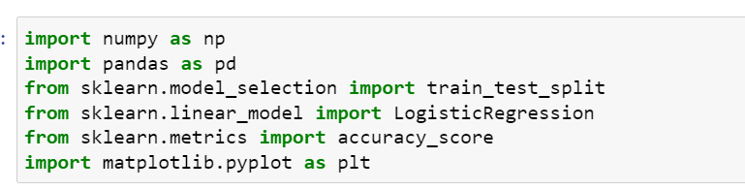
2. Import the libraries

Slide 10

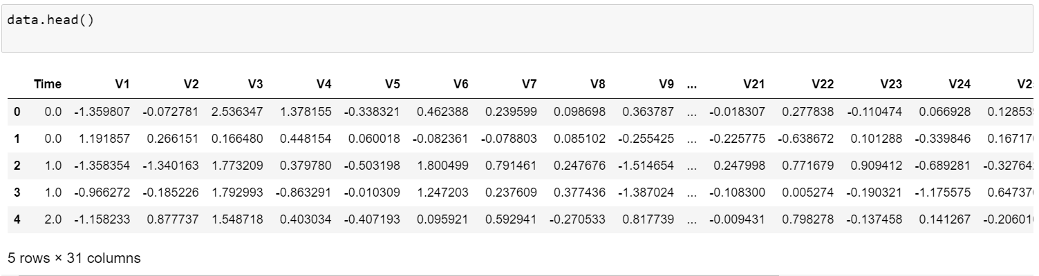
3. Reading Dataset
Firstly we will read the dataset into jupyter notebook. To read the dataset use command:
To check the header rows for dataset

Slide 11
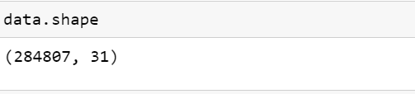
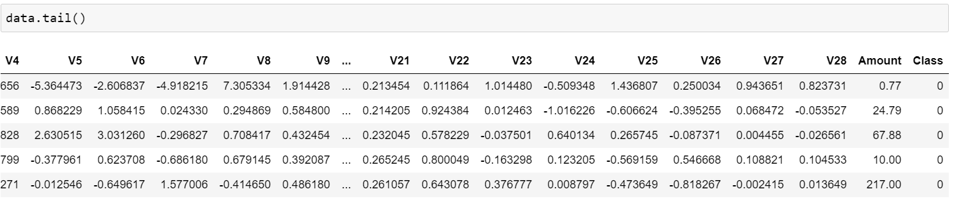
4. Exploring the dataset

Slide 12

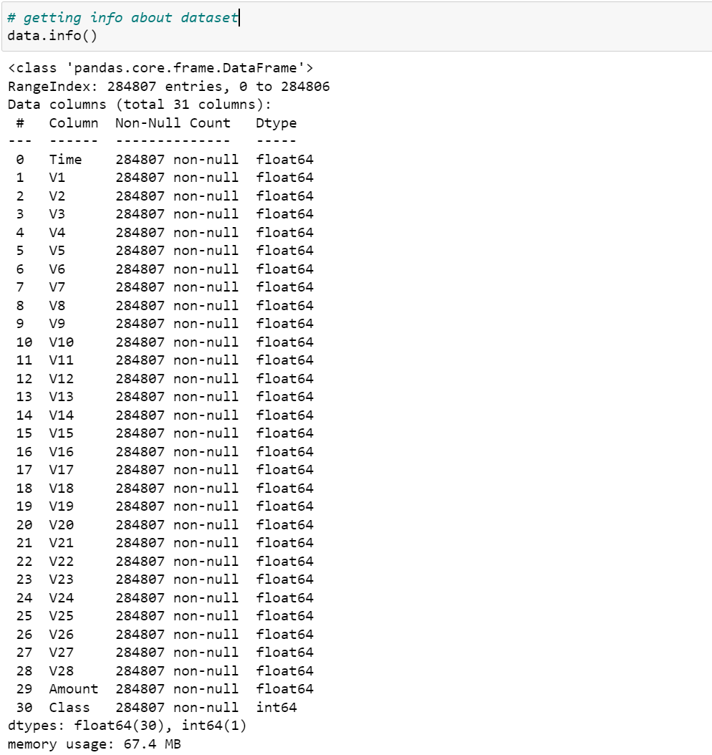

Slide 13
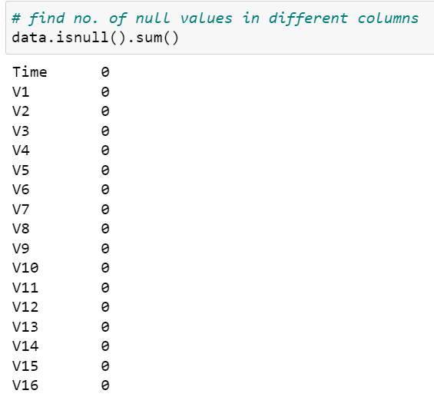
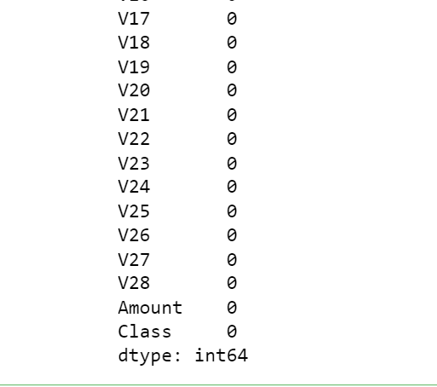
There is no null value in any column.

Slide 14
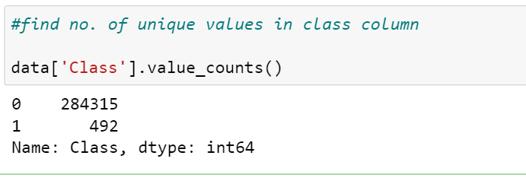
0 indicates that the the transaction was a legit transaction
1 indicates that the transaction was a fraudulent transaction
We can see that legit transaction are more than the fraud ones

Slide 15
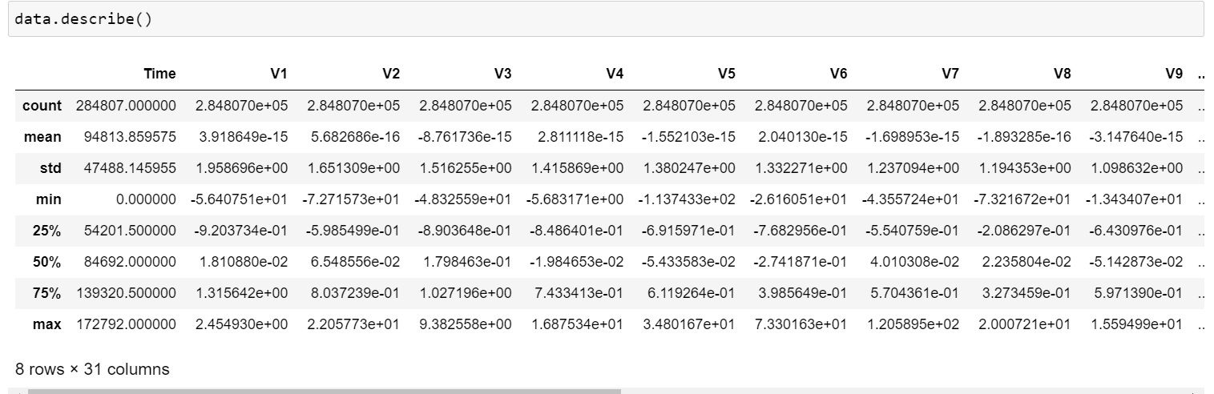

Slide 16

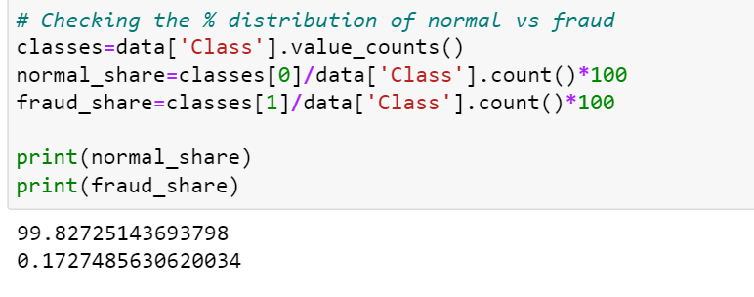
The dataset is highly unbalanced and hence it is unsuitable for applying any ML model

Slide 17
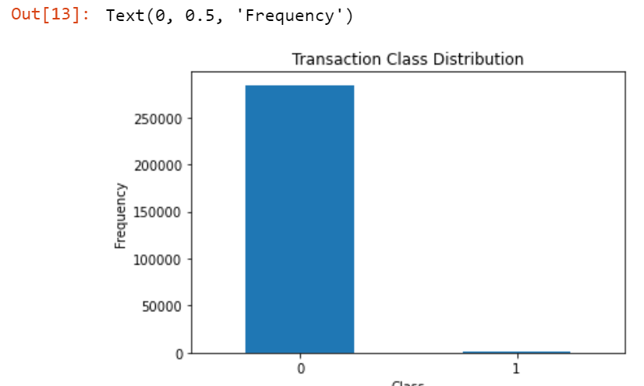
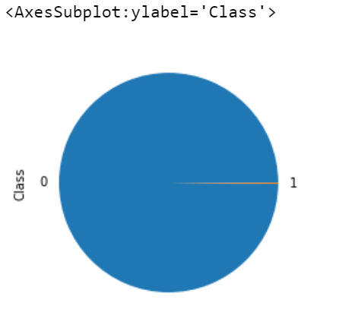
Some plots

Slide 18
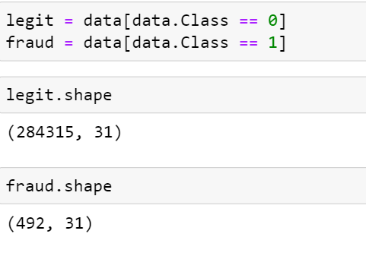
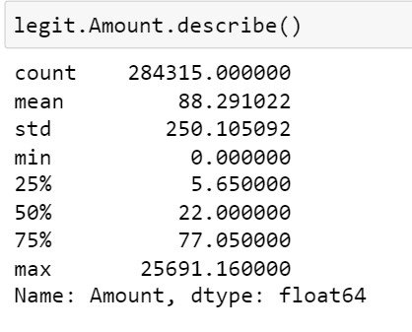
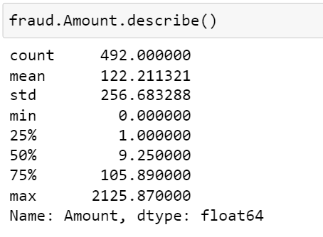
Since the dataset is highly unbalanced we have to balance it before training our model to generate accurate and precised results.

Slide 19
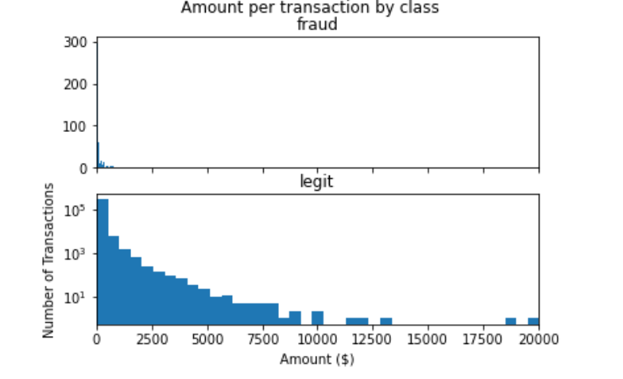
Insight: Only low amount transaction are done by fraud

Slide 20
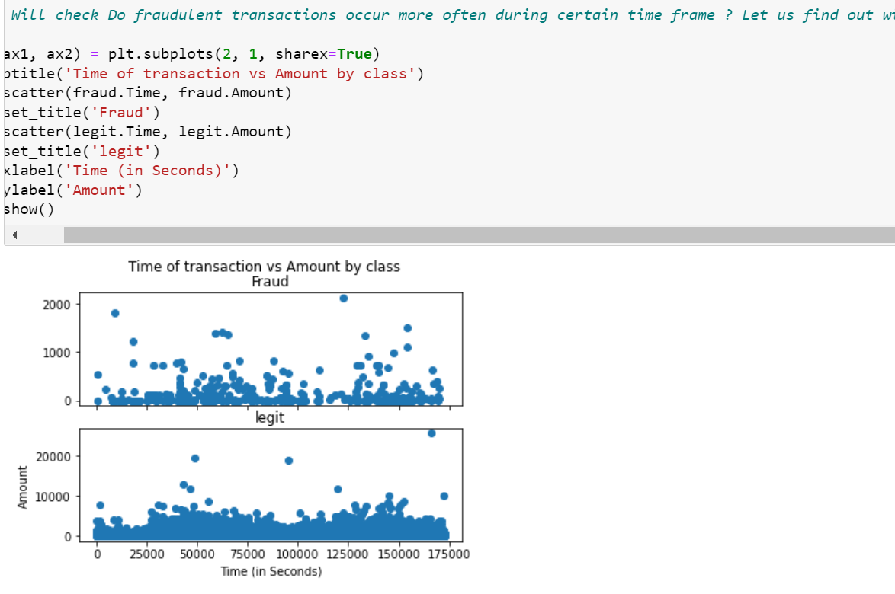

Slide 21
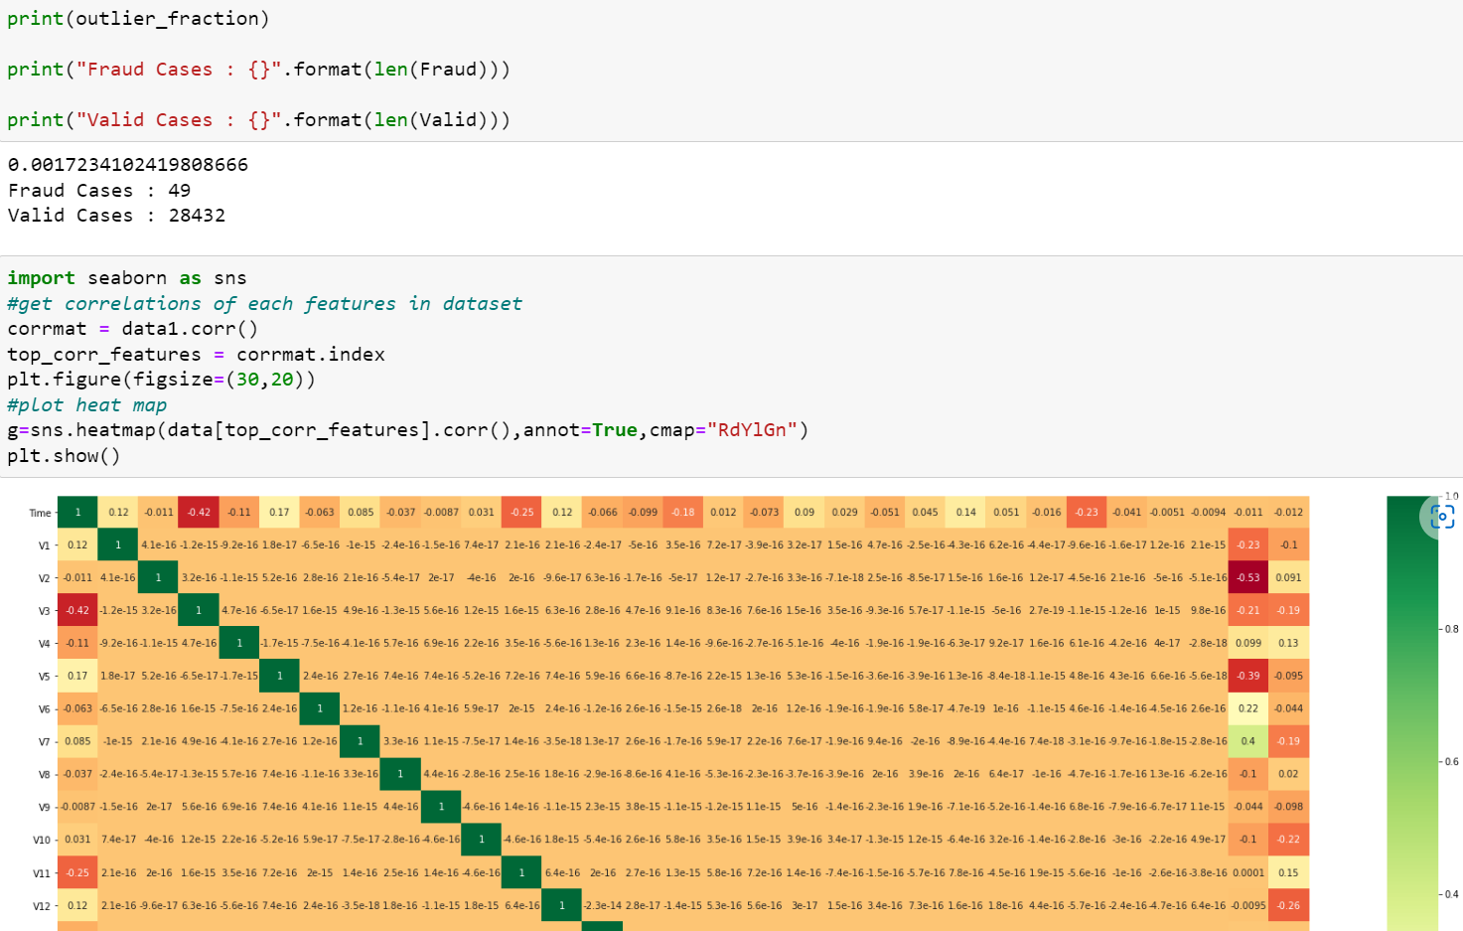

Slide 22
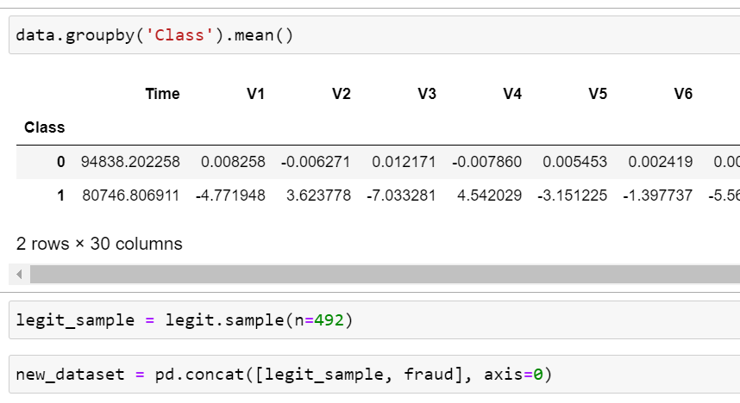
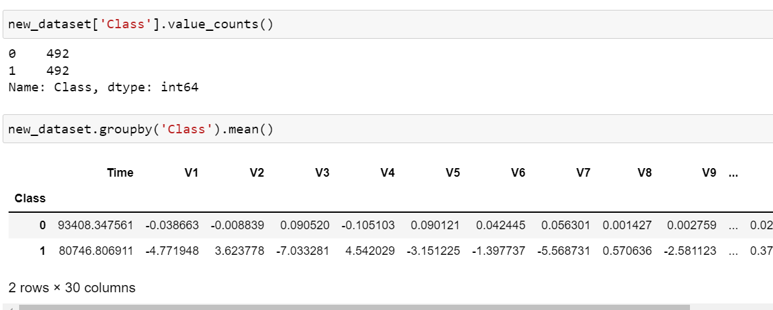
Fragmenting the dataset

Slide 23

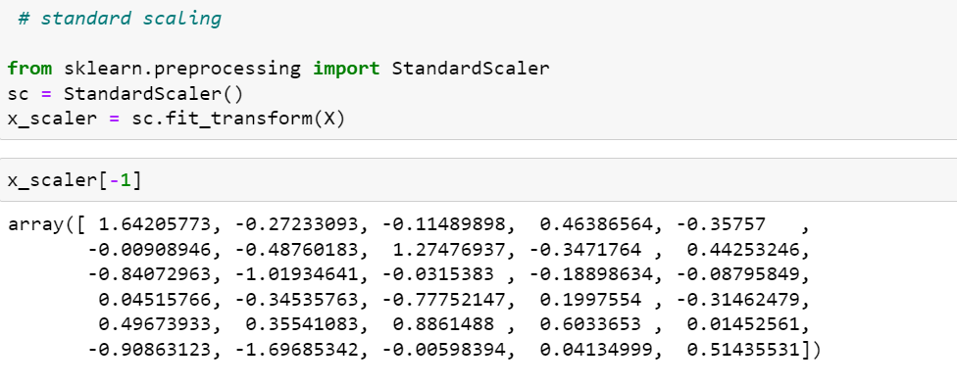
Dropping class column for unsupervised learning

Slide 24
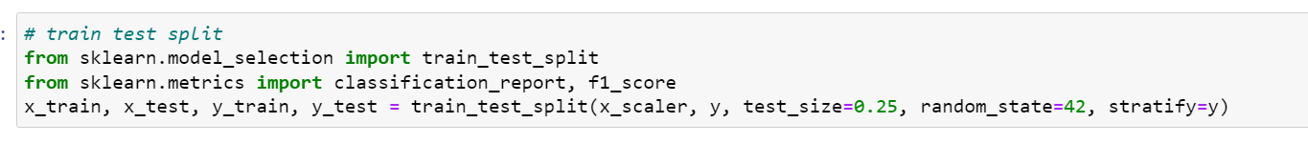
Splitting the dataset into train and test data . For this we use train_test_split from sklearn library.

Slide 25
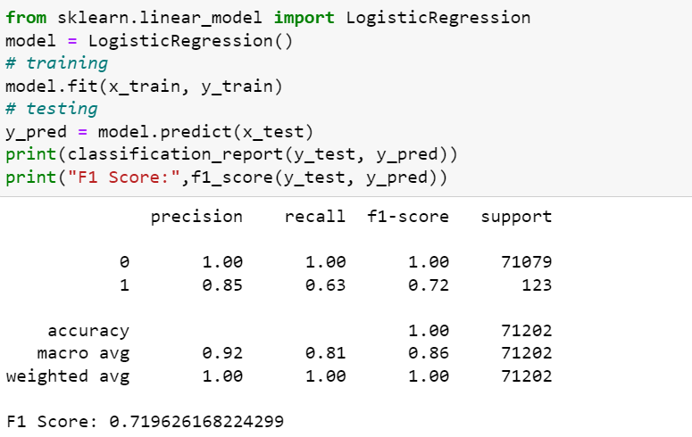
Finally we will train our model. For this we will use Logistic regression . By applying logistic regression we can see the accuracy and precision are good.
Still the precision is not as expected so will try to apply some other model.

Slide 26
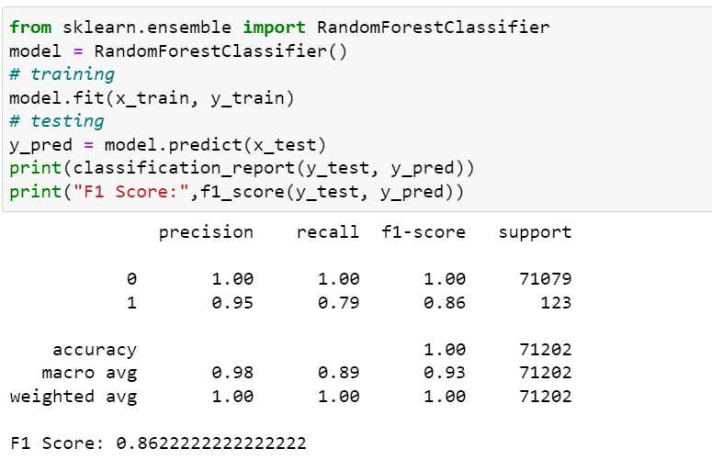
Let’s try an other model to train and find out the accuracy and precision of the model. This is Random Forest Classifier.
Precision and accuracy value are pretty good.

Slide 27
Conclusion
Since the random forest classifier gives better values for accuracy and precision. We can accept this and train our model. Finally we are ready with our machine learning model that can detect the fraudulent transaction if any.

Slide 28



